Slide 1

Balanced scorecard slide 1
GEO-EDGE
A GIS BASED ENTERPRISE APPLICATION FOR GEO-ANALYICS
Product Profile

Slide 2
PRODUCT INTRODUCTION
When you are managing any construction site, you have to make sure that everything is implemented according to the plan. You have to make sure that you do it right the first time, or you’ll have to start over again. Every small error while construction or earthworks could lead to huge losses. Hence, it is a very crucial task for the site engineers and workers to monitor the progress every day, every minute, again and again.
In today’s data driven generation, the Drone Surveying has made the site management and progress monitoring a whole lot easier. Mega Projects of earthworks and construction are being monitored using Drone and GIS data.
Geo-Edge is an Enterprise Platform that will allow you to analyze your Drone data easily. With our powerful GIS and machine learning plugins, anybody can assess the drone data and address any errors or issues in the activities in no time.
Generating Reports that takes days, can be done in minutes. Highlighting errors and correcting them can now be done at an early stage, hence, avoiding technical blunders in the projects.
You get simple and attractive visualization tools on the web bowser, no need to rely on complicated software, making it accessible anywhere and easily.
The platform is also compatible with Android and iOS mobile phones and Tabs, hence accessible on sites too.

Slide 3
KEY FEATURES
2D and 3D GIS data visualization (supports .shp, .obj, point cloud, GeoTIFF)
Multi-Layer overlay
Create beautiful Thematic Maps
Measurement tools- Distance, Area, Volume, Slopes, heights
Elevation Profile
Temporal Change detection tool
Dynamic Dashboard
Reporting tools

Slide 4








Balanced scorecard slide 2
INDUSTRIES WE SERVE
Mining
Oil & Gas
Utility Network
Management
E- Governance
Renewable Energy
Resources
Agriculture
Health & Sanitation
Military and Surveillance

Slide 5
Benefits
Survey cost reduction by 75%
Net-Profit Growth by 50%
Surveying and processing time decreased by 90%

Slide 6
Business Model
Basic Model (For SMEs) | Pay As You Go | Enterprise Model | Lifetime License

Slide 7
NEXT VERSION UPDATES

Slide 8
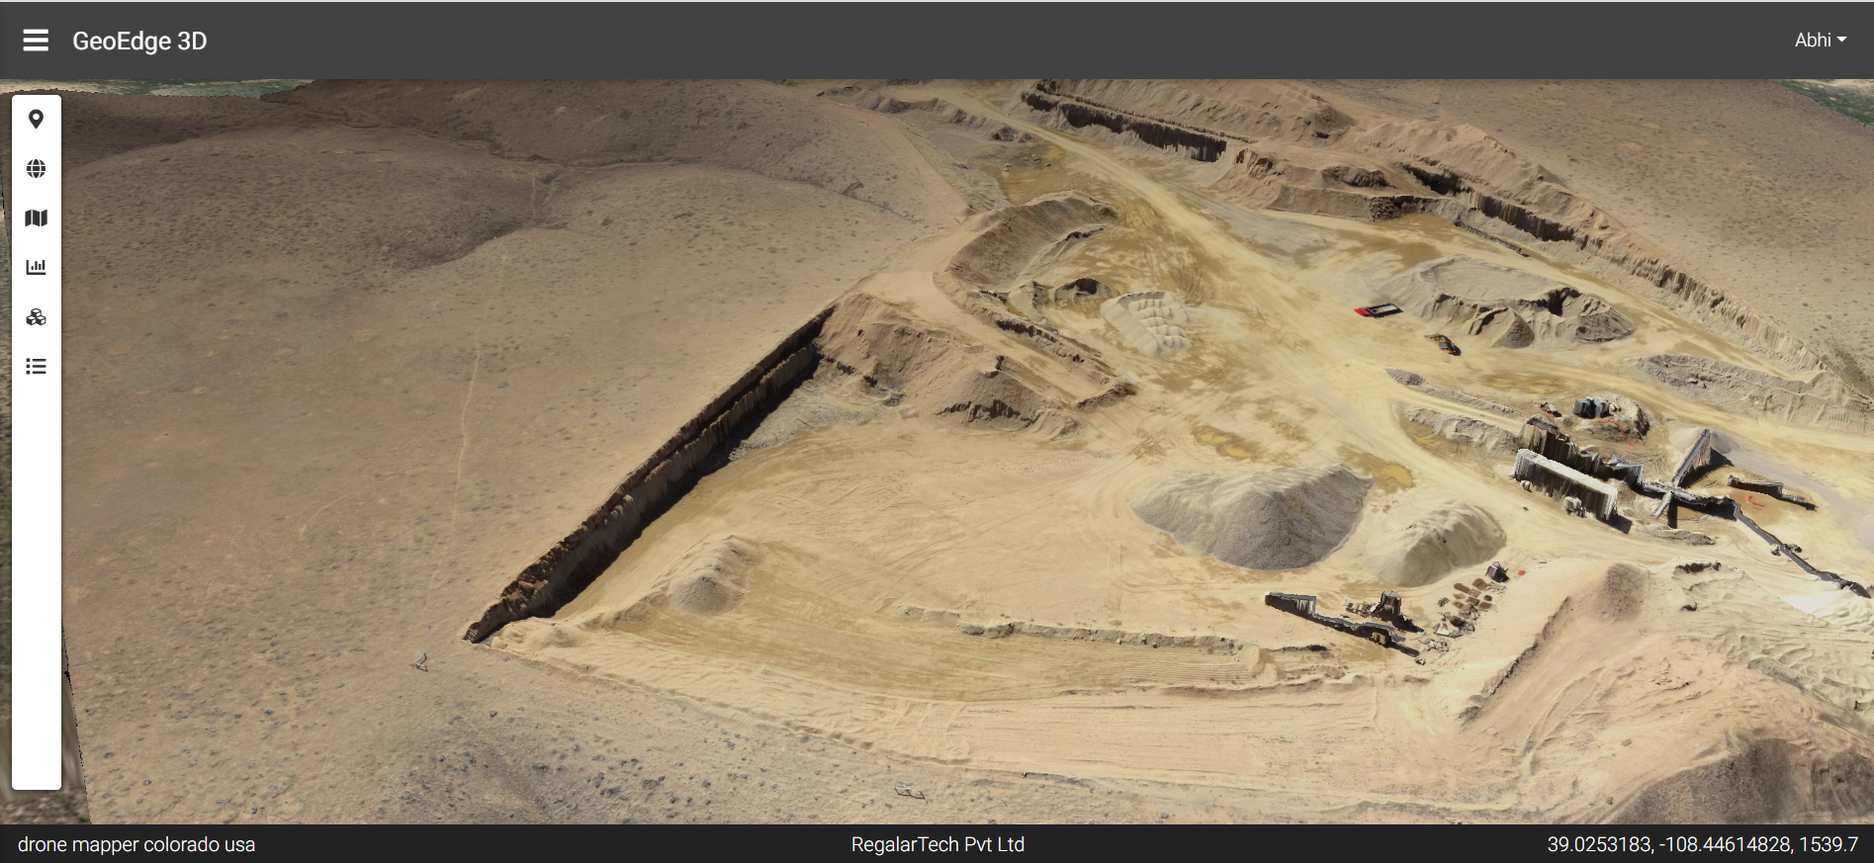
Screen Shots – Main Page

Slide 9
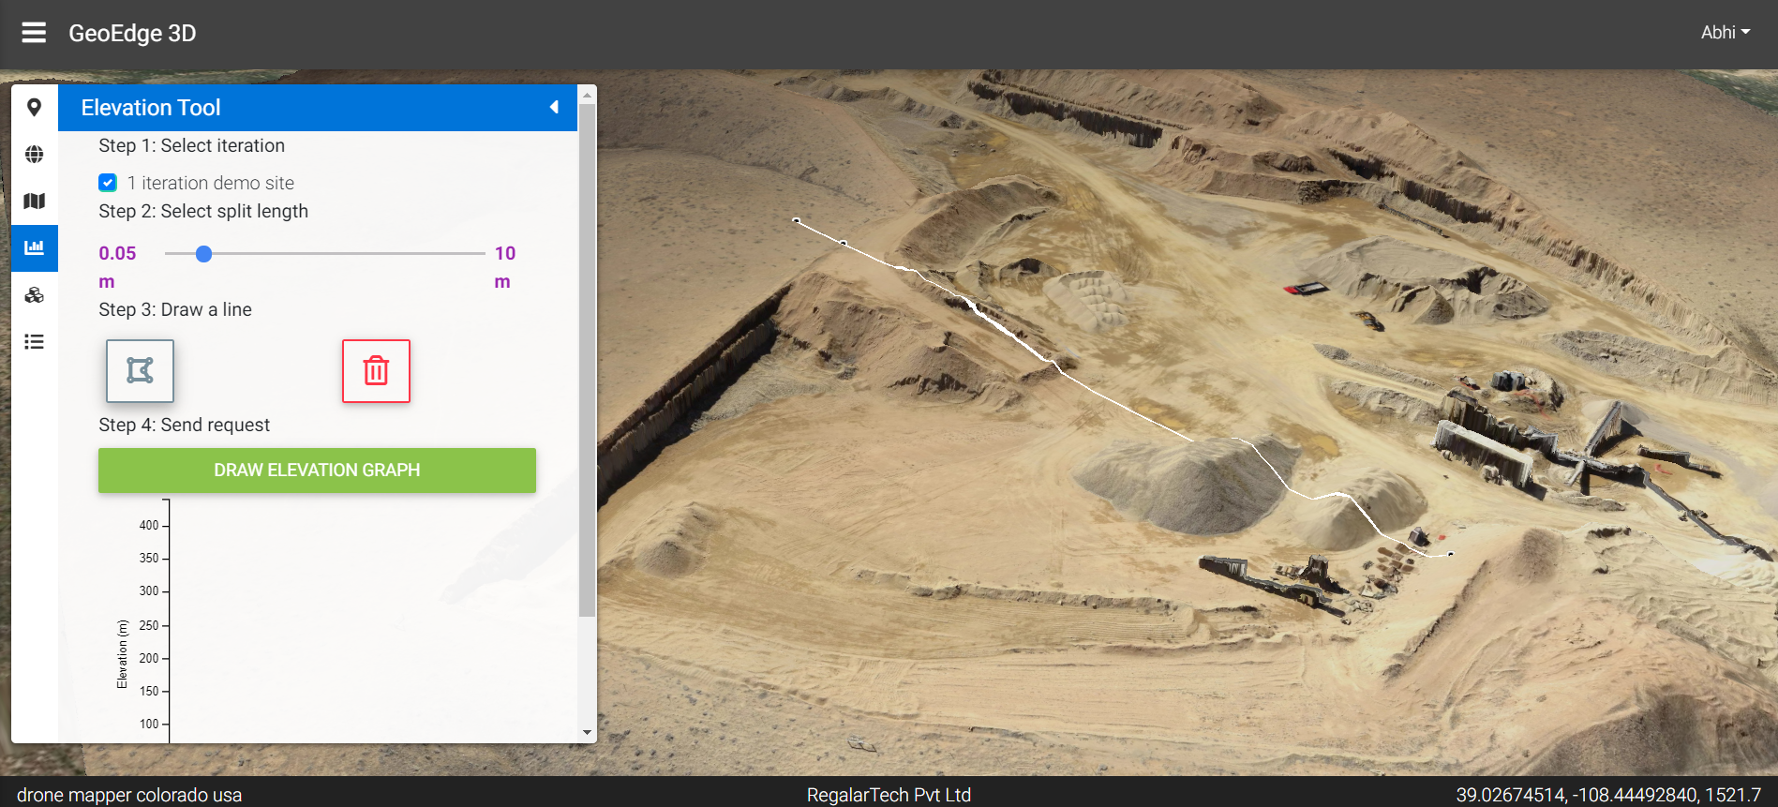
Screen Shots – Elevation Profile (step 1)

Slide 10
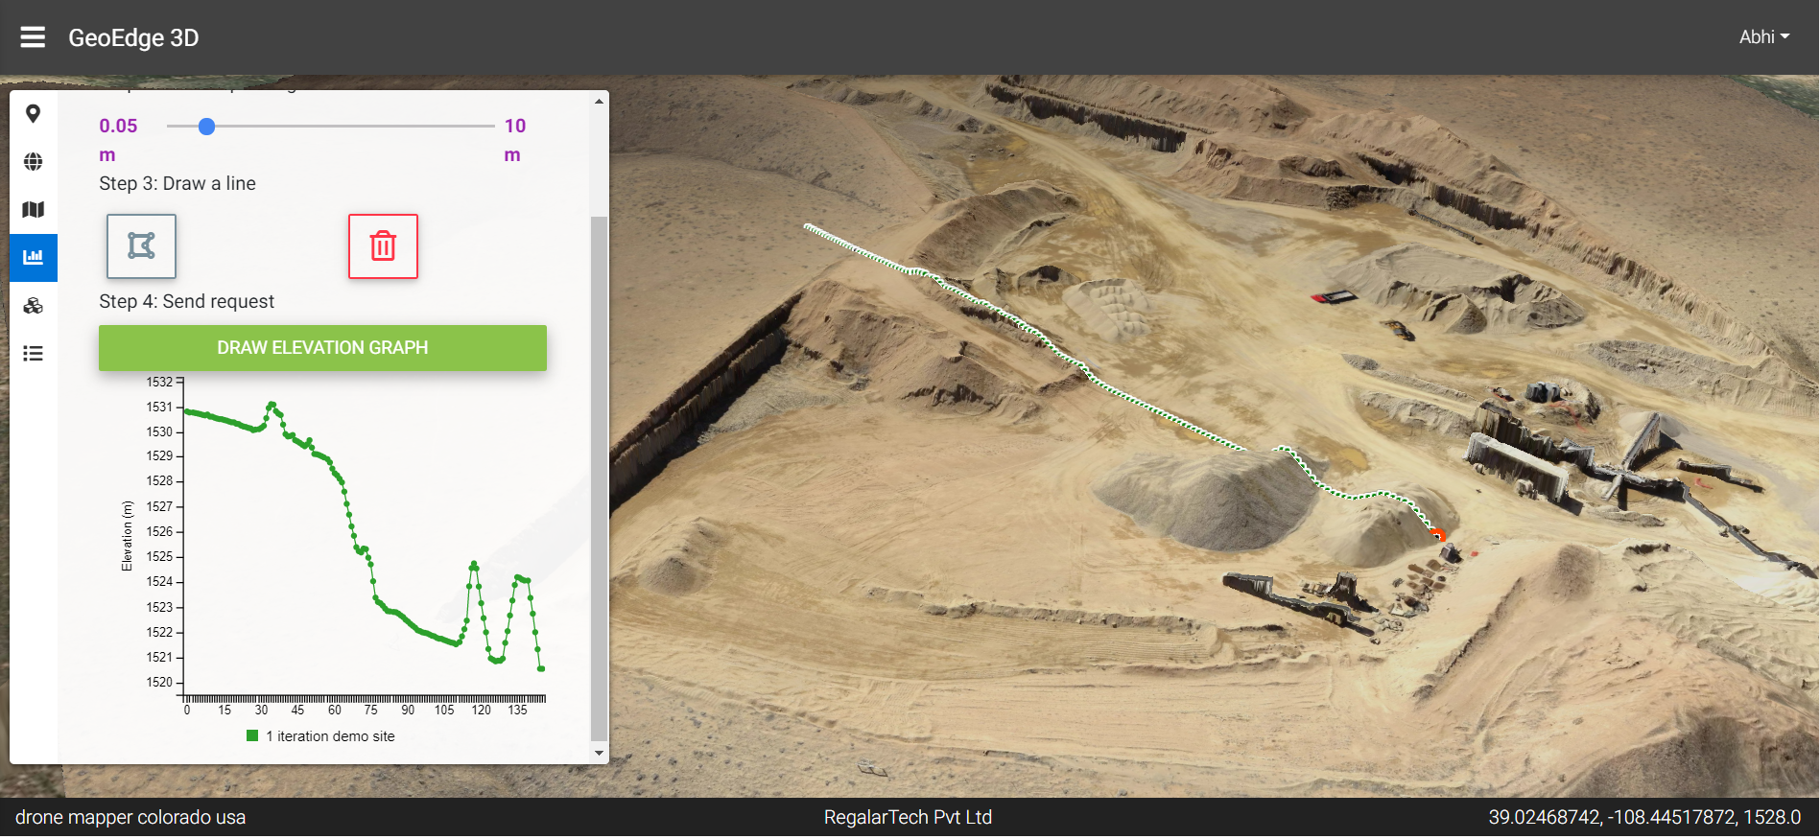
Screen Shots – Elevation Profile (step 2)

Slide 11
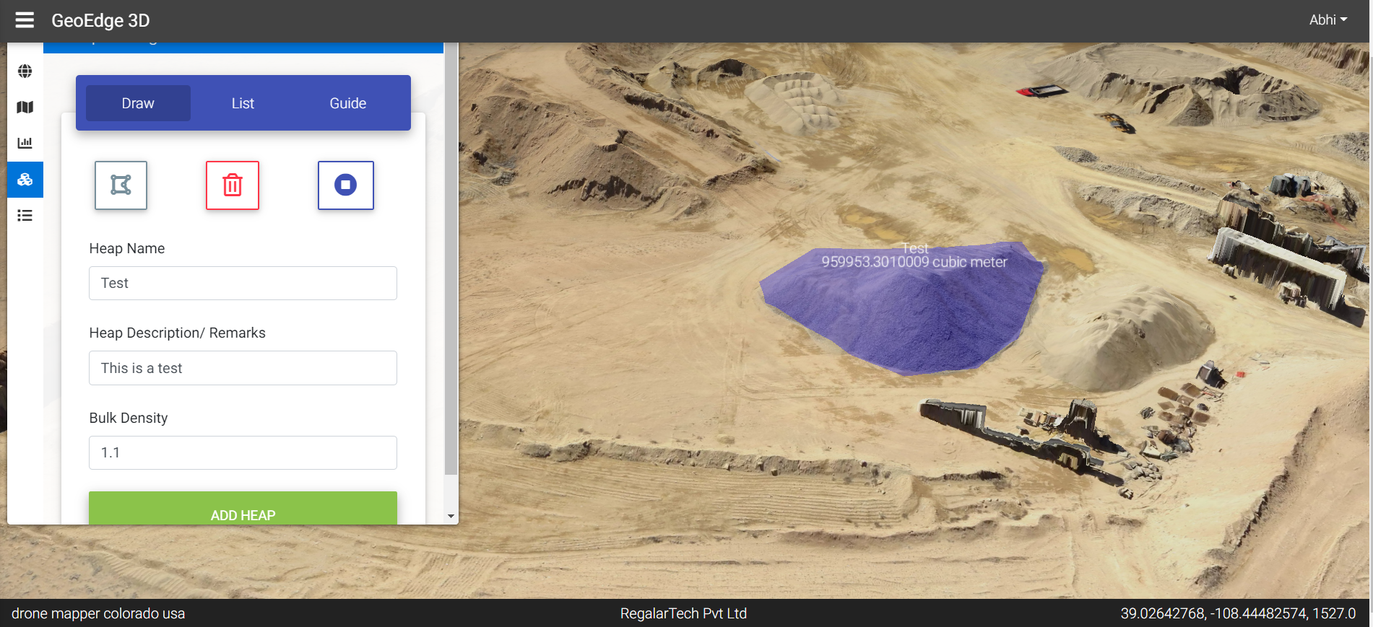
Screen Shots – Volumetric Calculation

Slide 12

OUR INVESTOR AND STRATEGIC PARTNER

Slide 13












OUR CLIENTS

Slide 14
Balanced scorecard slide 10
THANK YOU
www.regalartech.com
Address:
2A Pinnac Satyam, Baner road, Baner
Pune 411045 IND
Contact: +91 9970740936
Email: regalartech@gmail.com

